Slide 1
Automated trading model Oplevering sprint 0
Stockbrood

Slide 2
Inhoud
Architectuur
Prototype
User stories
Reflectie
Planning voor volgende sprint
Vragen?

Slide 3
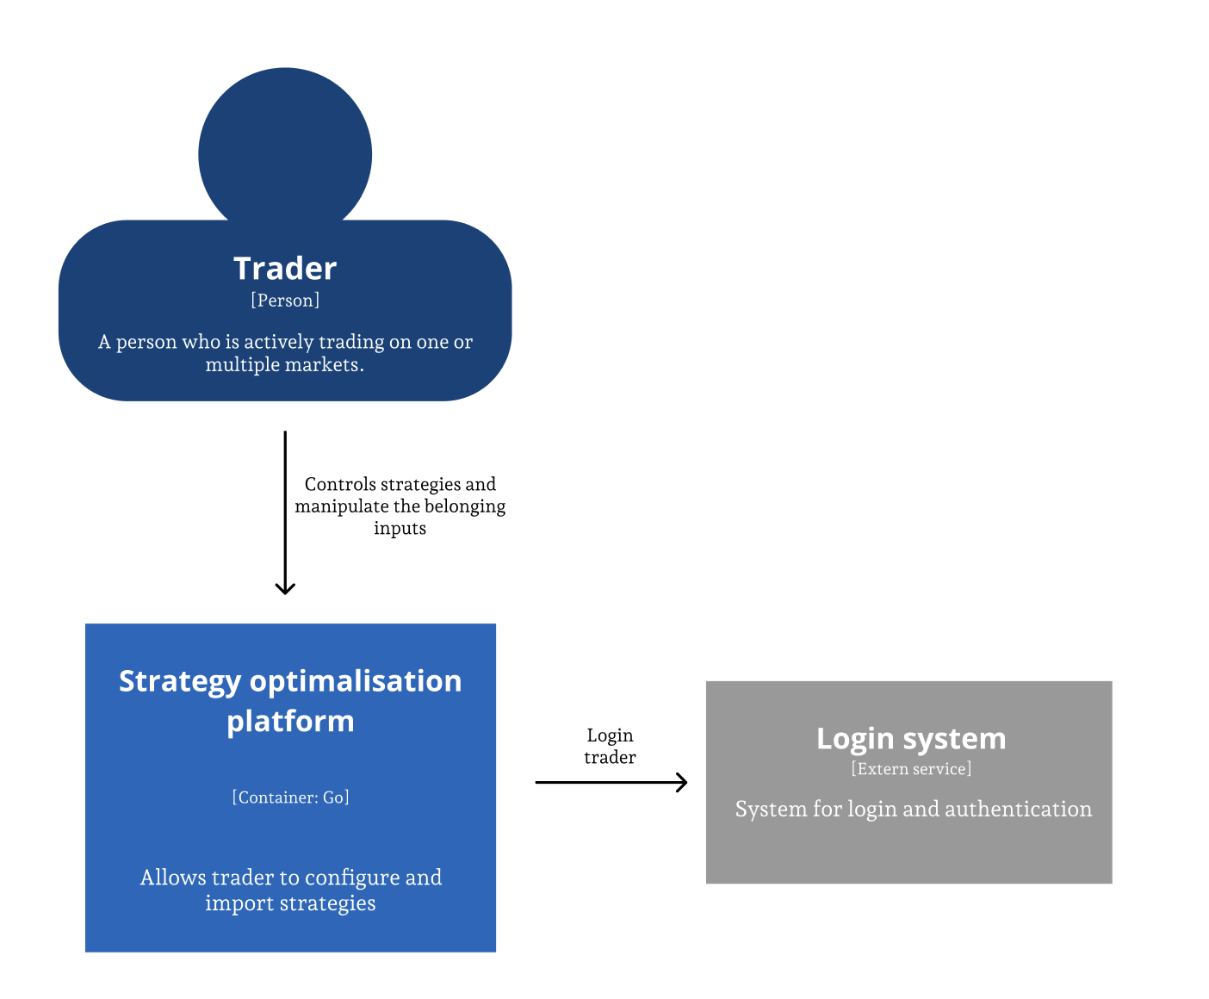
Architectuur

Slide 4
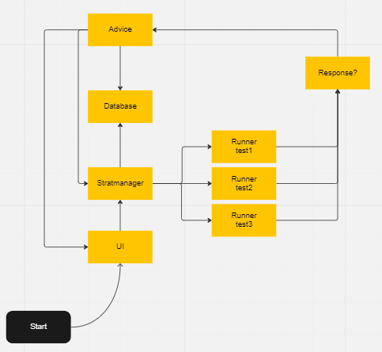
Architectuur

Slide 5
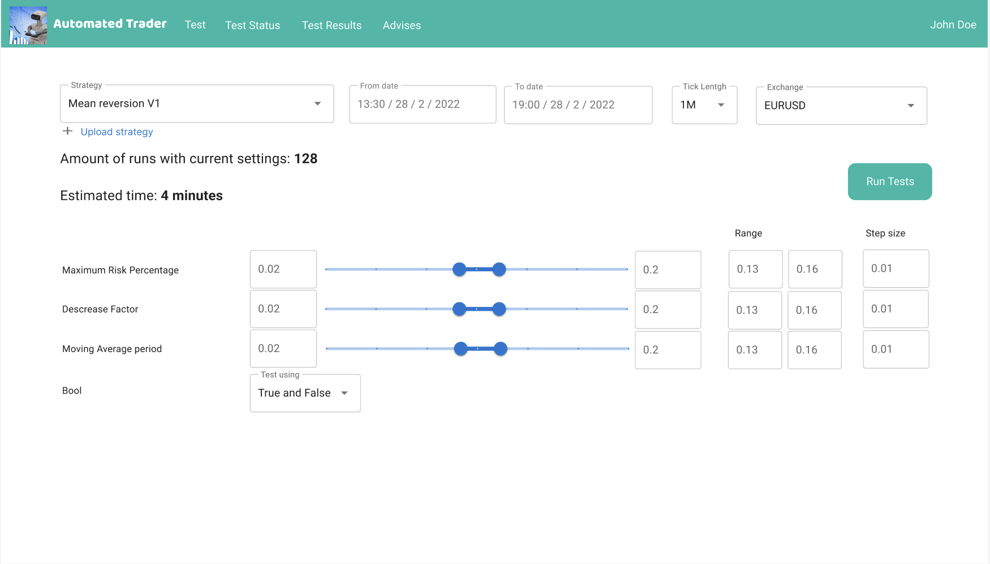
Prototype

Slide 6
User Stories
Title: Strategy upload | Priority: 5/5 | Estimate: 100/500
As a trader I want to be able to upload my trading strategies So I can pass them down to the test program.
Acceptance criteria: I can select a trading strategy on my local machine and upload it with the UI. All uploaded strategy should only be visible in my own account. I should be able to only upload supported file formats.
Title: Historical data | Priority: 5/5 | Estimate: 100/500
As a trader I want to be able to test my strategies on historical data So I can determine its performance over multiple time frames
Acceptance criteria: The trading data is from the last 3 weeks I am able to run tests with this data
Title: Interval | Priority: 5/5 | Estimate: 100/500
As a trader I want to be able to select a desired tick interval So I can test specifically on position changes in a specific time.
Acceptance criteria: The user can select a tick interval from a drop down. The tick interval values are determined upfront and should match the available data. While running the test the trading strategy should only be tested every selected tick interval.
Title: Scalability | Priority: 5/5 | Estimate: 450/500
As a trader I want to test my strategies as fast as possible So I can find the most optimal trading strategy easier
Acceptance criteria: The system will add a test instance if it improves the speed of the current test Multiple tests are running simultaneously
Title: Advice | Priority: 5/5 | Estimate: 200/500
As a trader I want to be able to get an advice So I can use the best possible strategy.
Acceptance criteria: This advice contains information about the profit that will be made from the running test
Title: Strategy variables | Priority: 5/5 | Estimate: 200/500
As a trader I want to test different variable ranges in my strategies So the system can determine all possible outcomes.
Acceptance criteria: All variables used in the strategy are visible to the user. The numeric variables can be ranged by the user. While testing the strategy all of the possible values inside the selected ranges need to be tested.
Title: Advice criteria | Priority: 4/5 | Estimate: 200/500
As a trader I want to be able to select criteria to formulate the advice So I can adjust the advice to my personal preference.
Acceptance criteria: The user can select a variable from the trading strategy to test the results on. The user can select properties of the graphs representing the strategy performance.

Slide 7


Documenten

Slide 8
Reflectie
Basis
Kennis van technieken
Metatrader 5
Basis kennis over automated trading

Slide 9
Sprint 1 planning
US prioriteren
Skelet van architectuur
Front-end
Inlogsysteem

Slide 10
Vragen?
Gelegenheid voor opmerkingen/vragen

